Slide 1

IET PATHSHALA
A VIRTUAL CLASSROOM
SUPERVISORS:
Prof. Vineet Kansal
Dr. Promila Bahadur
SUBMITTED BY:
Aakriti Agarwal (1805213001) Pragati (1805213037) Shuvanshu Gupta (1805213056)

Slide 2
INTRODUCTION
Today’s virtual classrooms are online spaces. A virtual classroom environment ensures human connection, a vital element of classroom teaching that video-on-demand courses don’t have and sorely miss. In a virtual classroom, teachers interact with students in real time, students can voice their questions and interact with peers similar to how they would in a regular classroom, albeit over the internet [2,5].
However, virtual classrooms also make use of pre-recorded components such as videos, presentations, and lecture slides to facilitate learning, much like offline classrooms do.

Slide 3
Motivation
The effect of pandemic [1] on the education sector has resulted in the shift of education mode to online. From classes to tests, everything was forced to happen virtually. Unfamiliarity and randomness to the situation [6] could affect the studies. Hence, there is a need for an application which enables teachers as well students to maintain curriculum in an organised manner. Also, it must aggregate all the academic activities while keeping data secure.Conventional classroom based teaching involves the delivery of course lectures by the lecturer in a particular place at a specific time. Hence it imposes a constraint of time and place on both the instructor and the student. Due to the human factor, the lecturer may not always be able to put the optimum effort towards preparing and delivering course models [3].

Slide 4
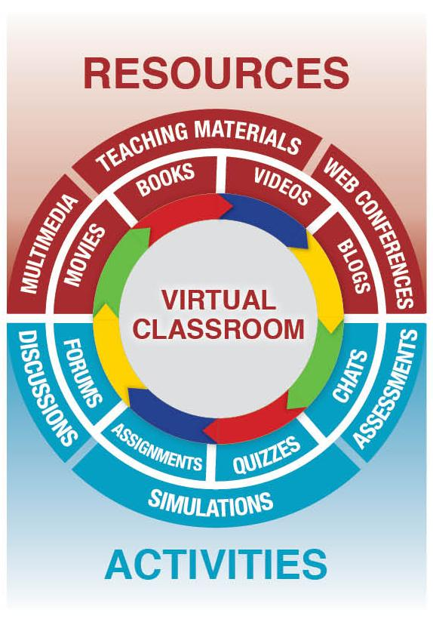
NEED
The effect of pandemic on education sector has resulted the shift of education mode to online. From classes to tests, everything is forced to happen virtually. Unfamiliarity and randomness to the situation could affect the studies. Hence, there is a need of an application which enables teachers as well students to maintain curriculum in an organized manner. Also, it must aggregate all the academic activities while keeping data secure [4].

Slide 5

OBJECTIVE
The aim of this project is to provide the institution, a full stack web application that will be a free blended learning online space, customized as per institution needs. By using this application data will be more secure as it resolves the problem of dependency on third party apps. It aims to aggregate all the virtual activities carried out by the institution enabling smooth flow of academic activities.

Slide 6
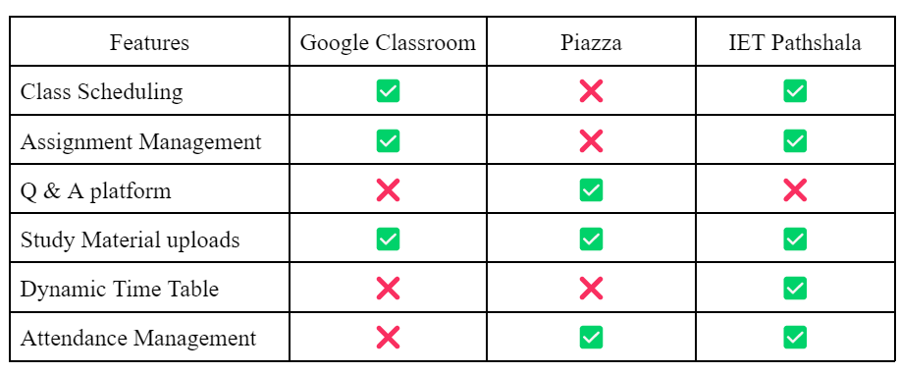
FEATURES COMPARISON CHART

Slide 7
FEATURES
Simple, intuitive and interactive UI
Easy Onboarding
A personalized Classroom web application that keeps data secure by not using any third party application.
Supports multi user tier of admin, faculty, class representative, and students.
In house assignment submissions and grading.
Dynamic real time timetable avoiding conflict between classes, streamlining student experience.

Slide 8
FEATURES
Easy access/download to study resources.
Dedicated forms section for feedback, doubts etc. with added functionality of reminders.
Dedicated section for placement related information, enabling students to apply for ongoing placement drives.
.

Slide 9
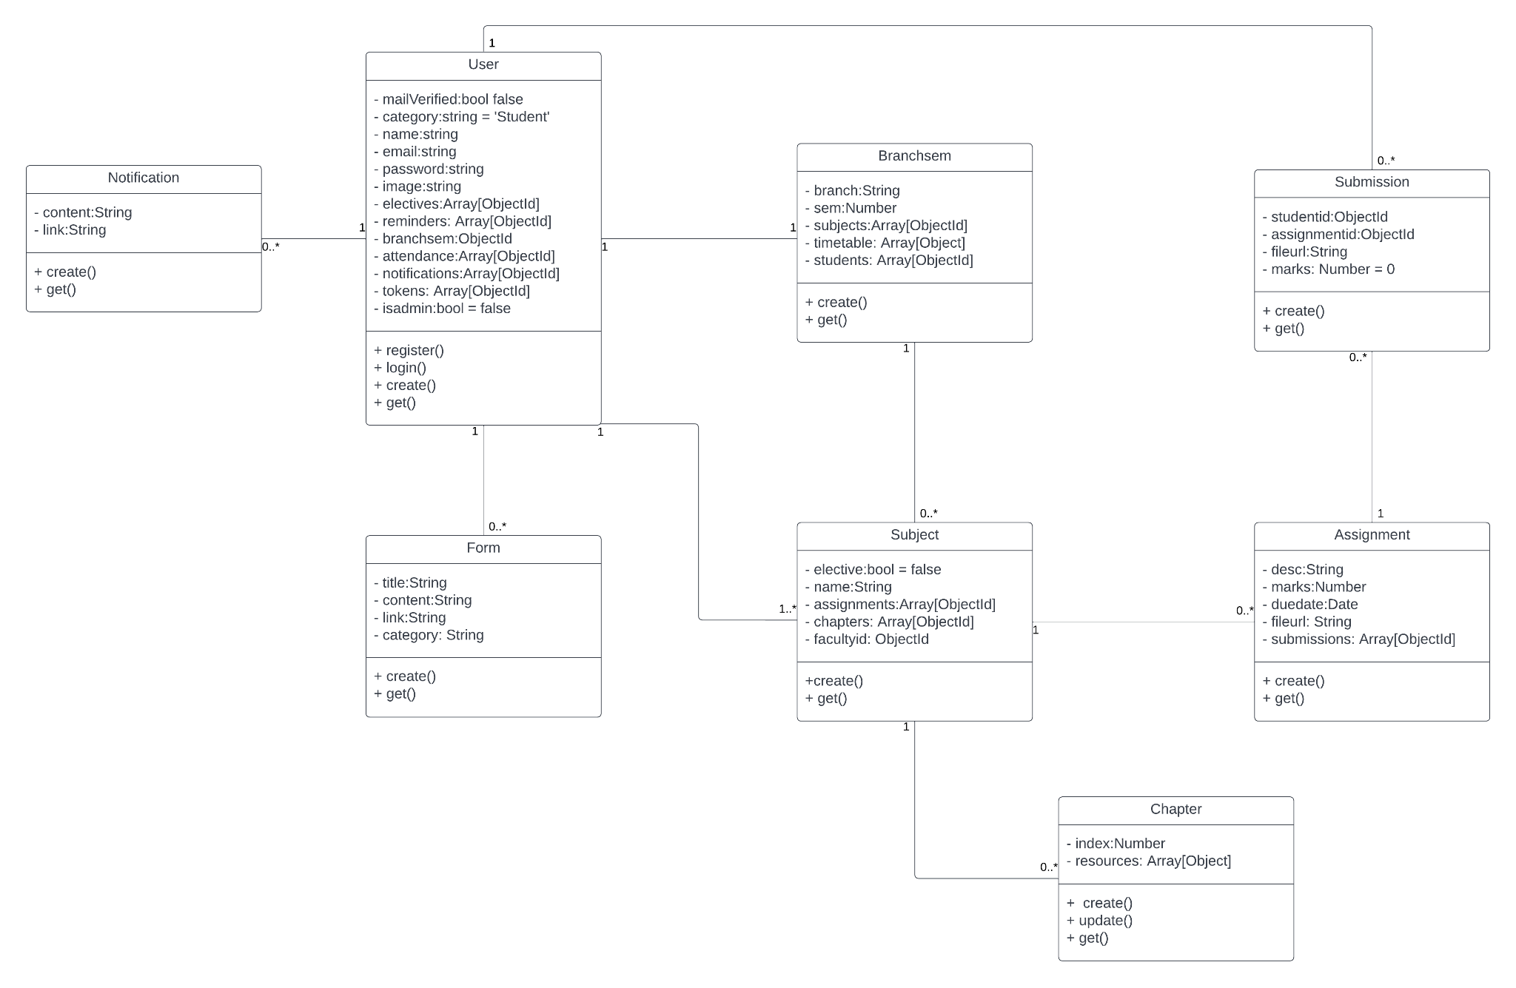
CLASS DIAGRAM

Slide 10
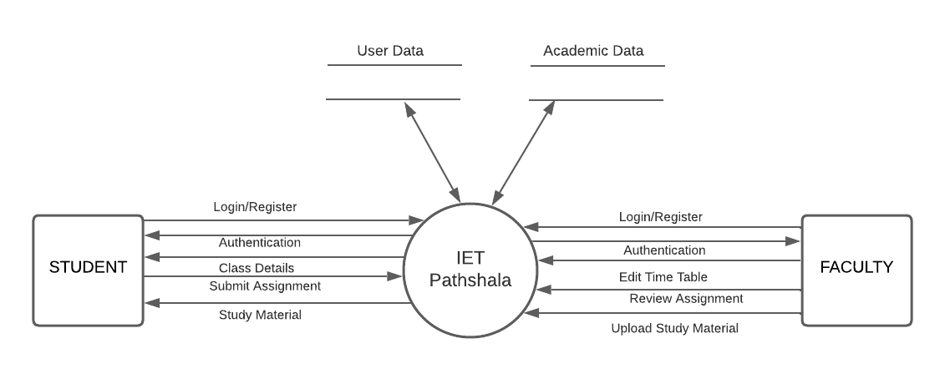
DATA FLOW DIAGRAM (LEVEL-0)

Slide 11
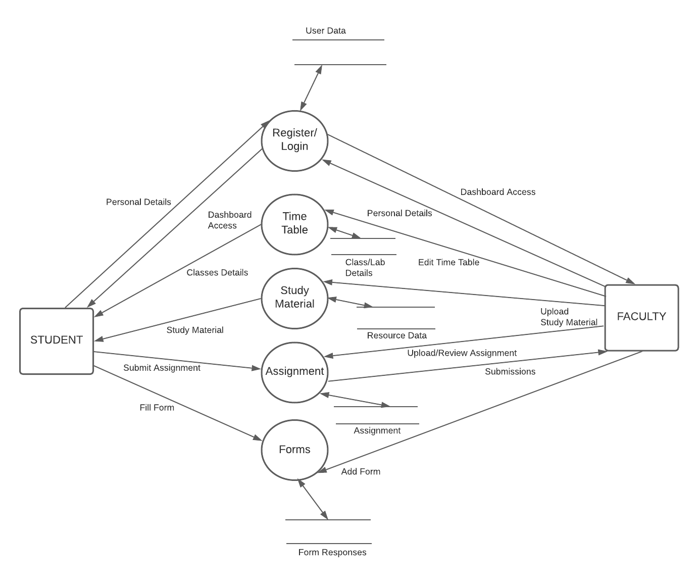
DATA FLOW DIAGRAM (LEVEL-1)

Slide 12
ACTION PLAN
PRD + ERD
Elementary UI Development
Backend Development
Testing + Deployment
Dec
Jan
Feb
Mar
Apr-May
UI Development
Backend Development

Slide 13
TECHNOLOGY USED
GUI Frontend- HTML/CSS, Bootstrap, JavaScript
Backend- NodeJS, ExpressJS
IDE- Visual Studio Code
Database- MongoDB Atlas
API Usage- Google Open Source APIs
Version Control System- Github, Git Bash
Deployment- Heroku
Other Tools- Jest, Postman, Nodemailer, MongoDB Compass, Joi

Slide 14
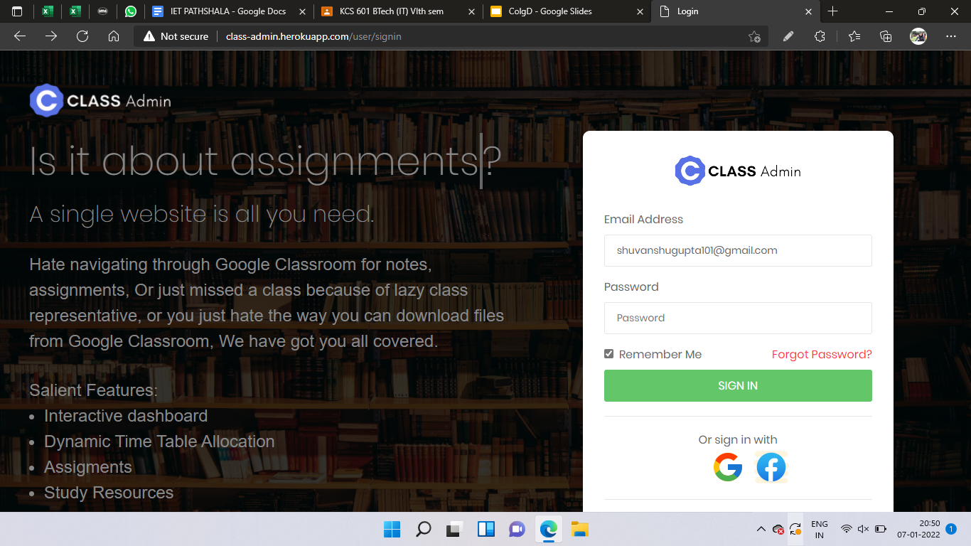
Snapshots
Figure 1. Sign in Screen

Slide 15
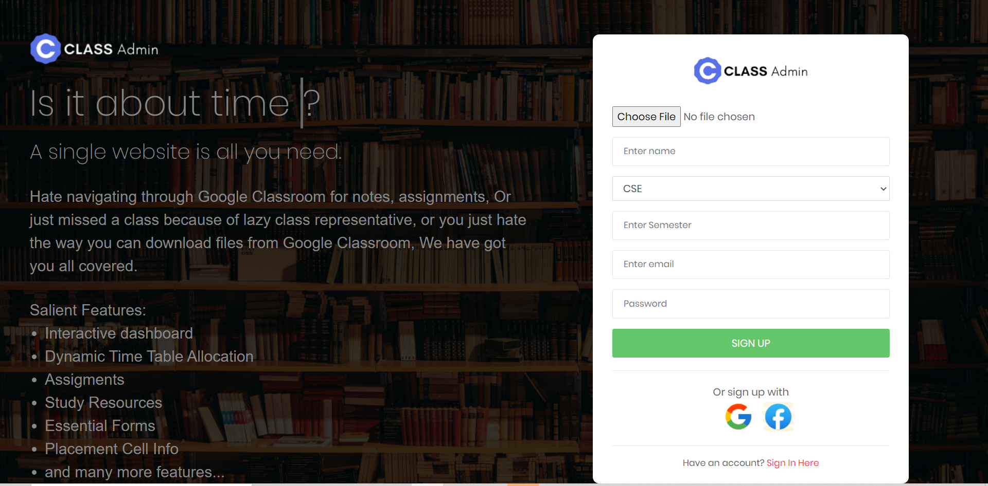
Figure 2. Sign up Screen

Slide 16
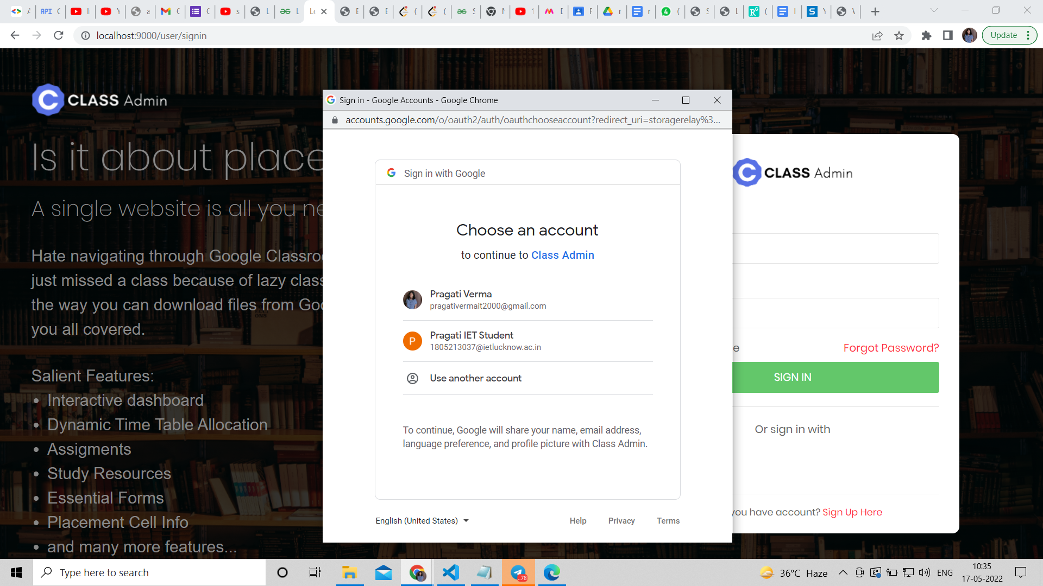
Figure 3. Google Authentication Screen while login and signup

Slide 17
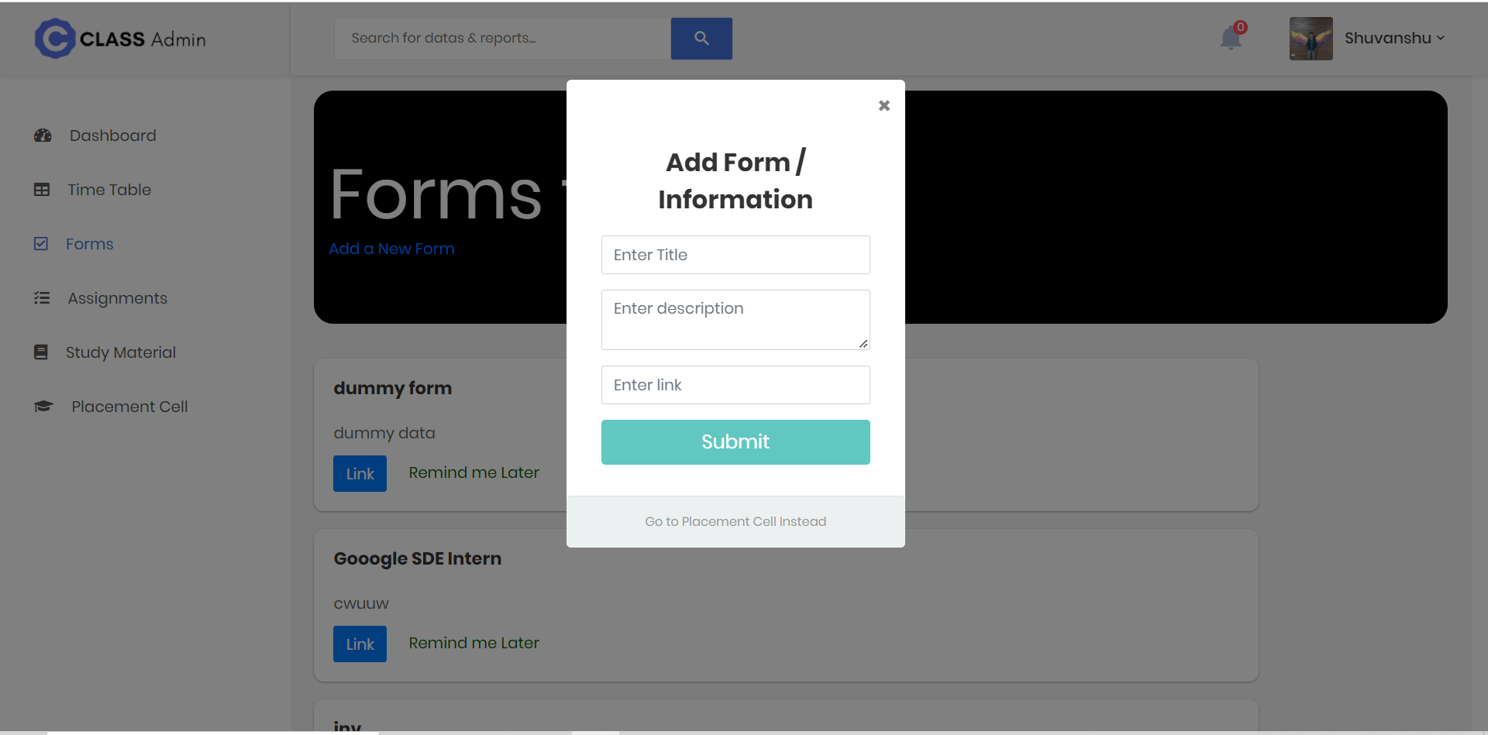
Figure 4. Add form/placement cell info modal form screen

Slide 18
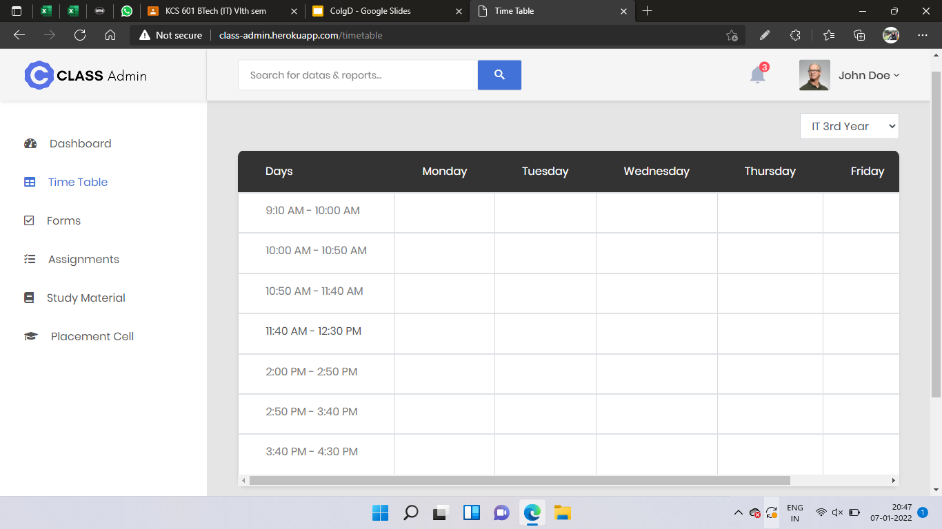
Figure 5. Time table Screen

Slide 19
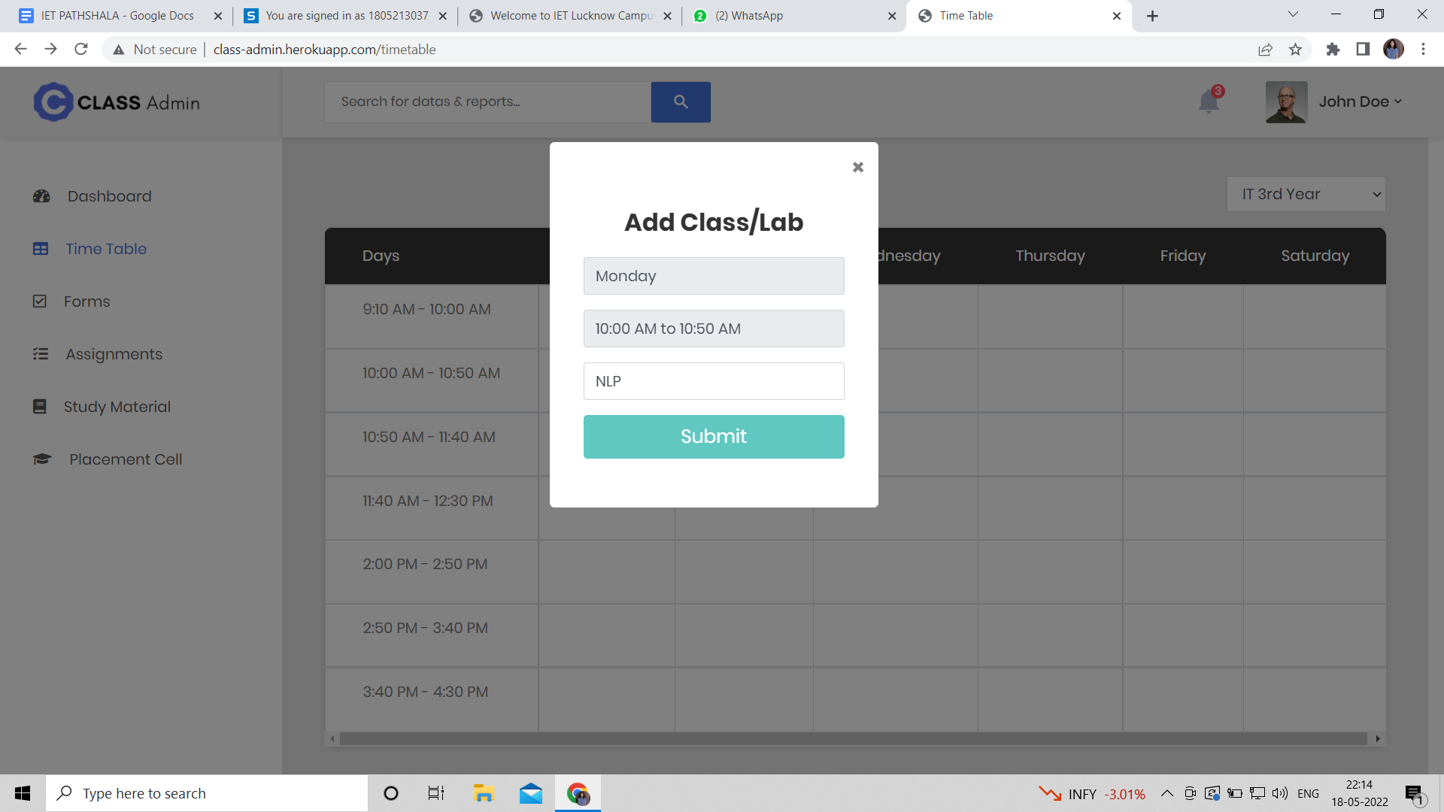
Figure 6. Add Class/Lab screen for faculty user role

Slide 20

Figure 7. Assignment Screen (no assignment selected) for student user role

Slide 21
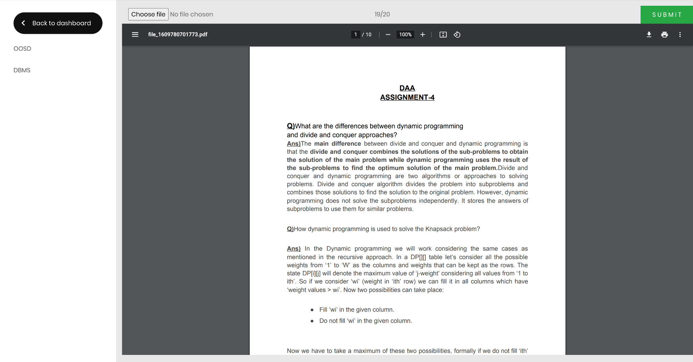
Figure 8. Assignment Screen for Student User role

Slide 22
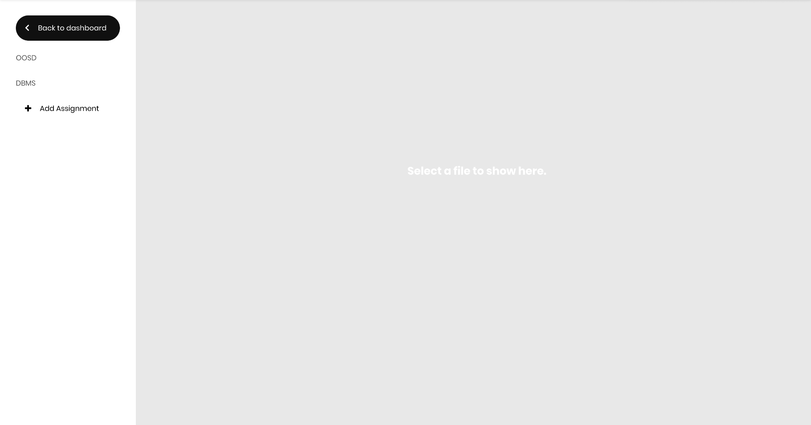
Figure 9. Assignment Screen for Faculty User role

Slide 23
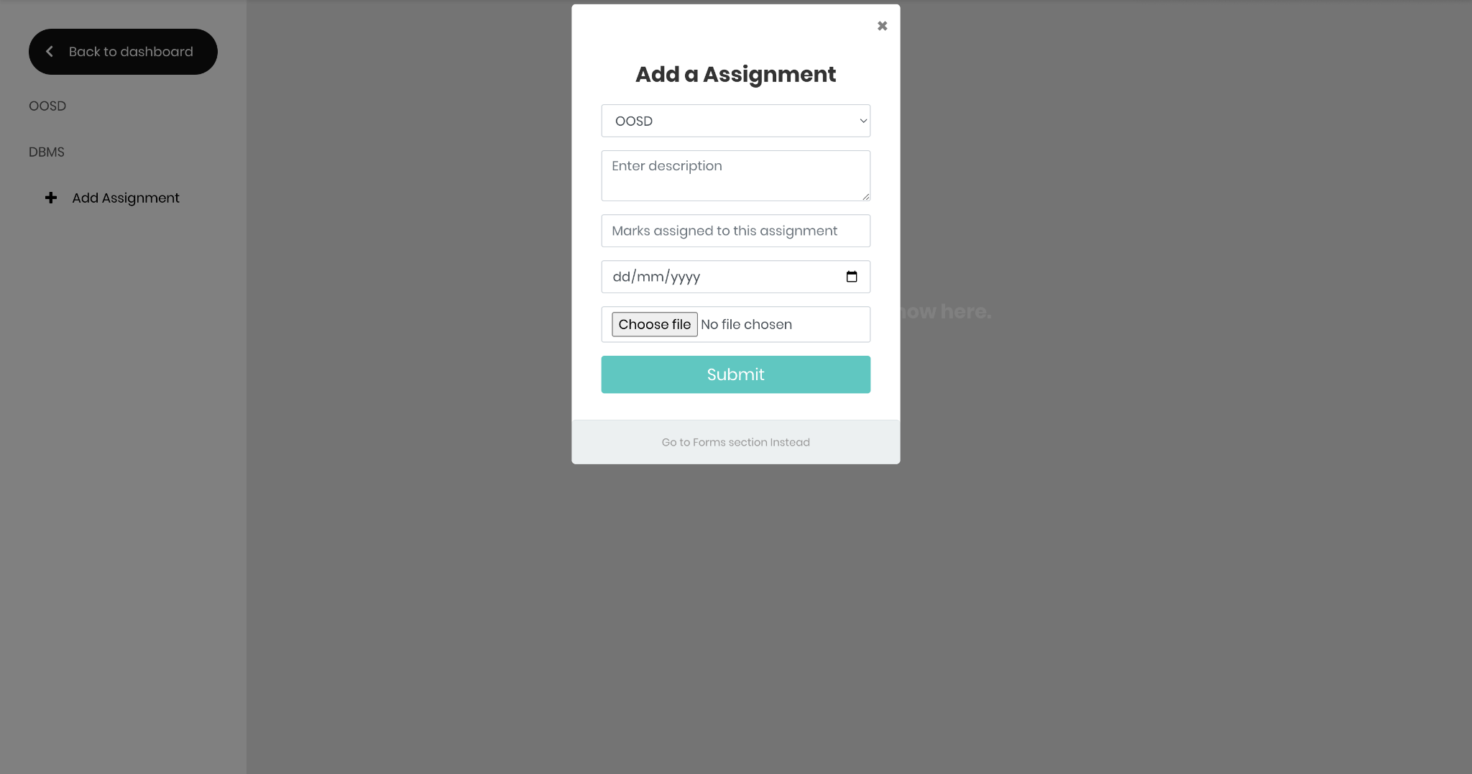
Figure 10. Add Assignment Screen for Faculty User role

Slide 24
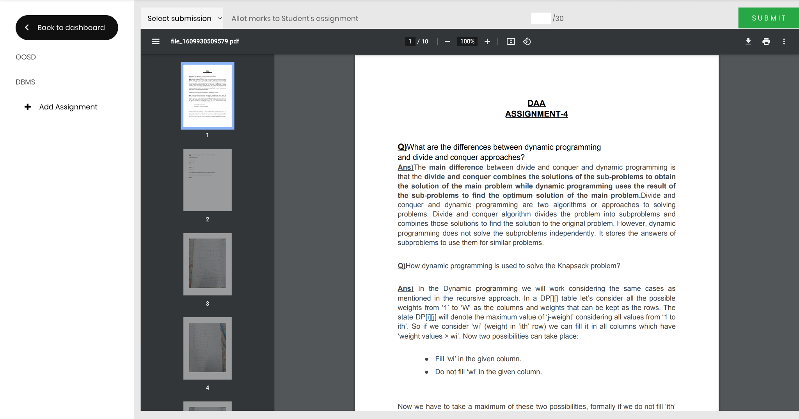
Figure 11. Assignment Screen for Faculty User role

Slide 25
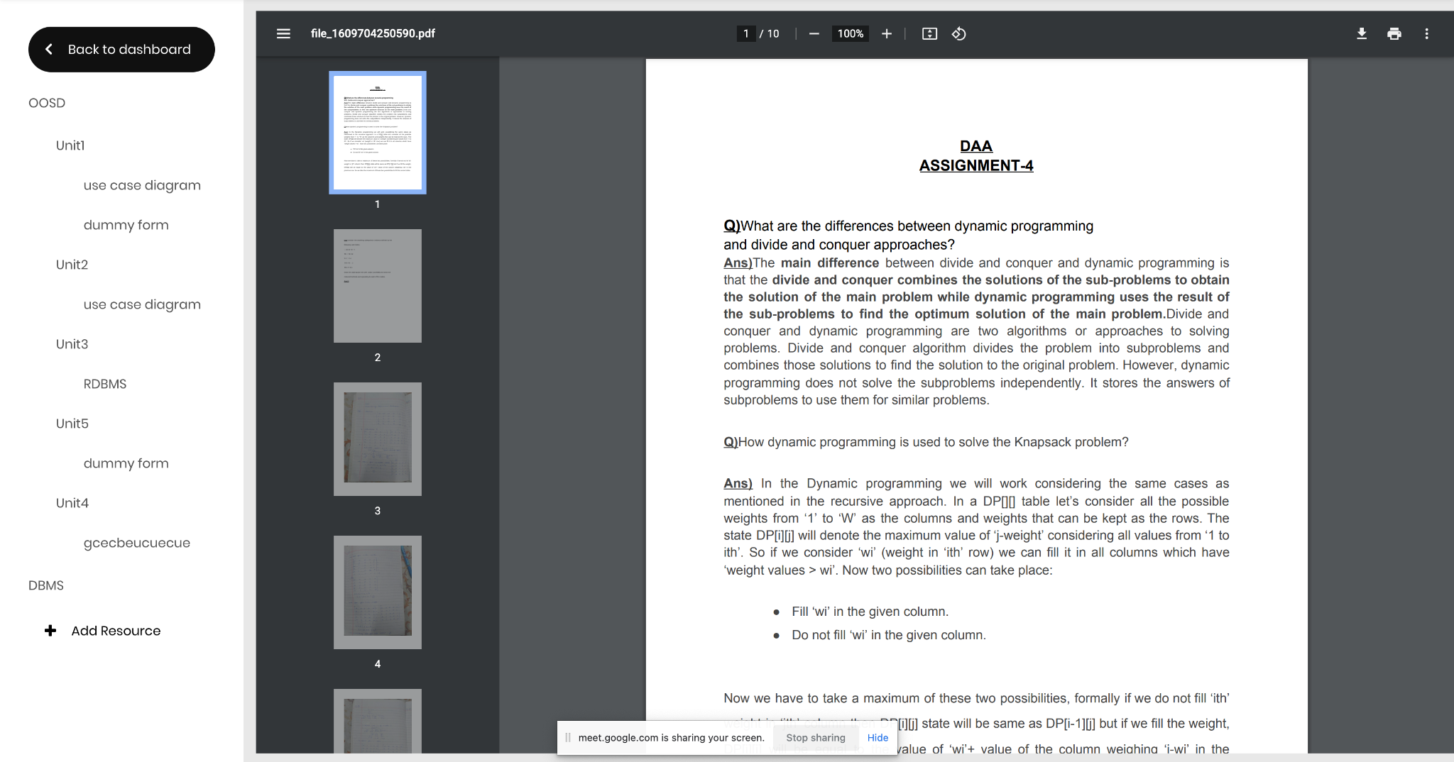
Figure 12. Study Material Screen for Faculty User role

Slide 26
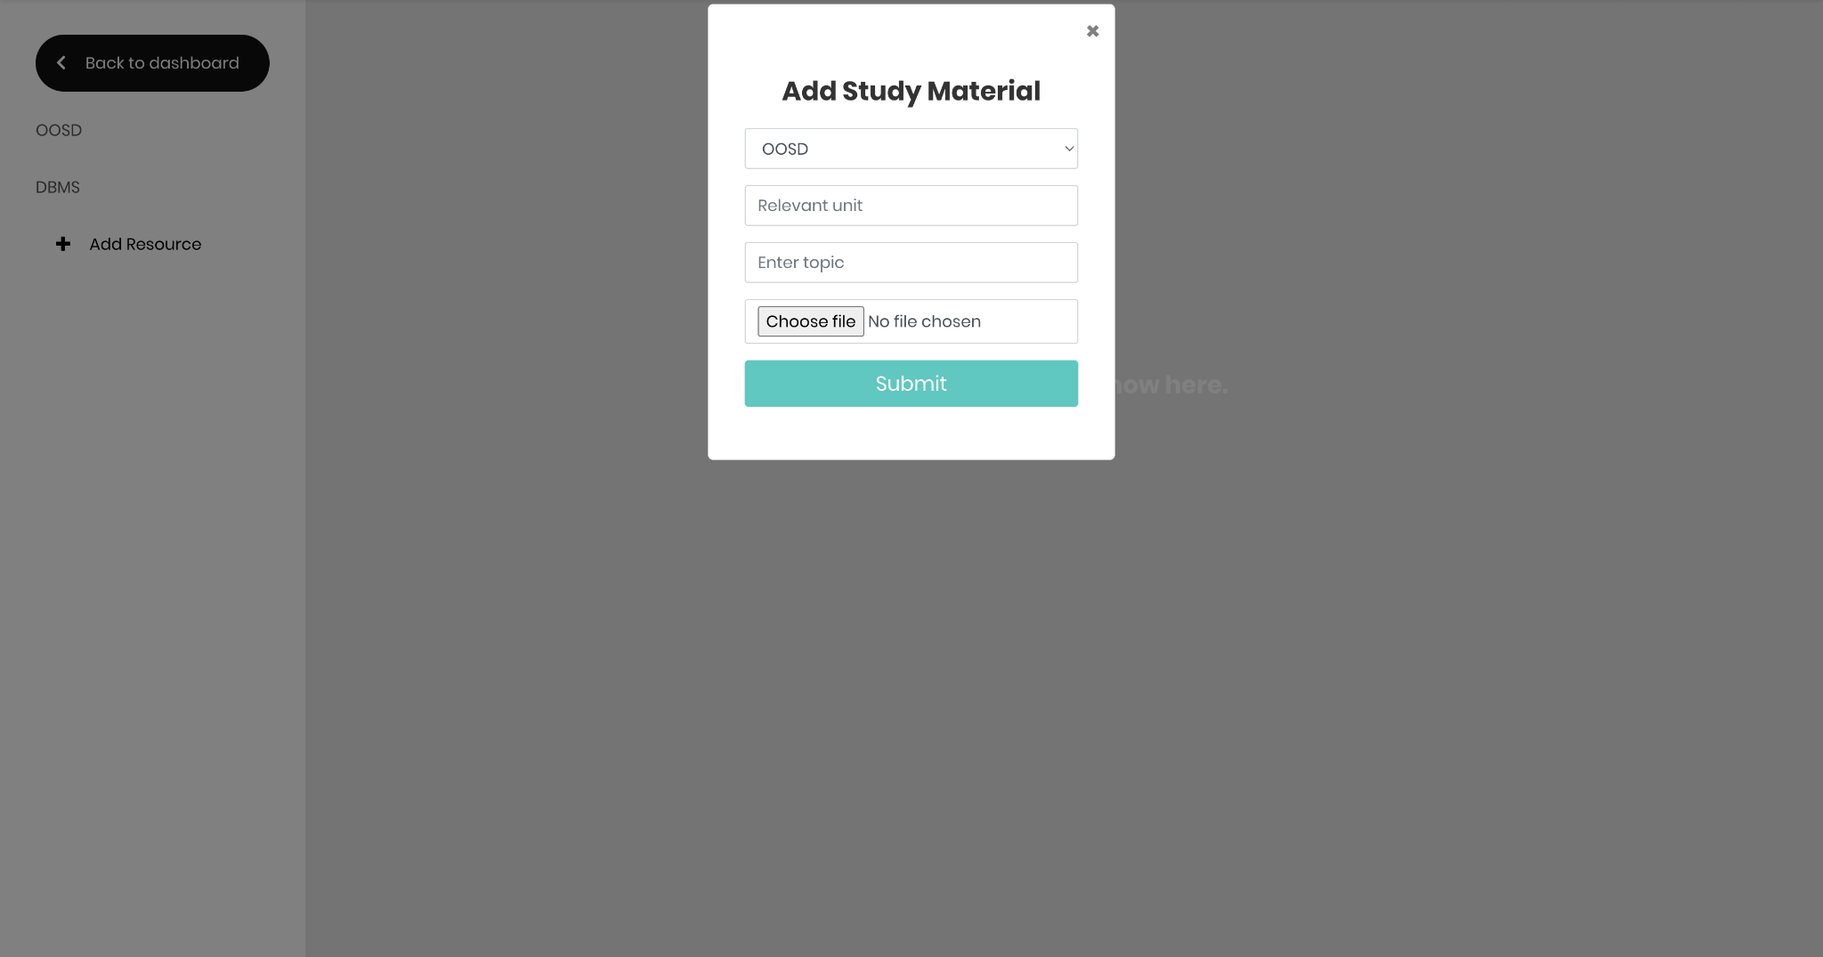
Figure 13. Add Study Material Screen for Faculty User role

Slide 27
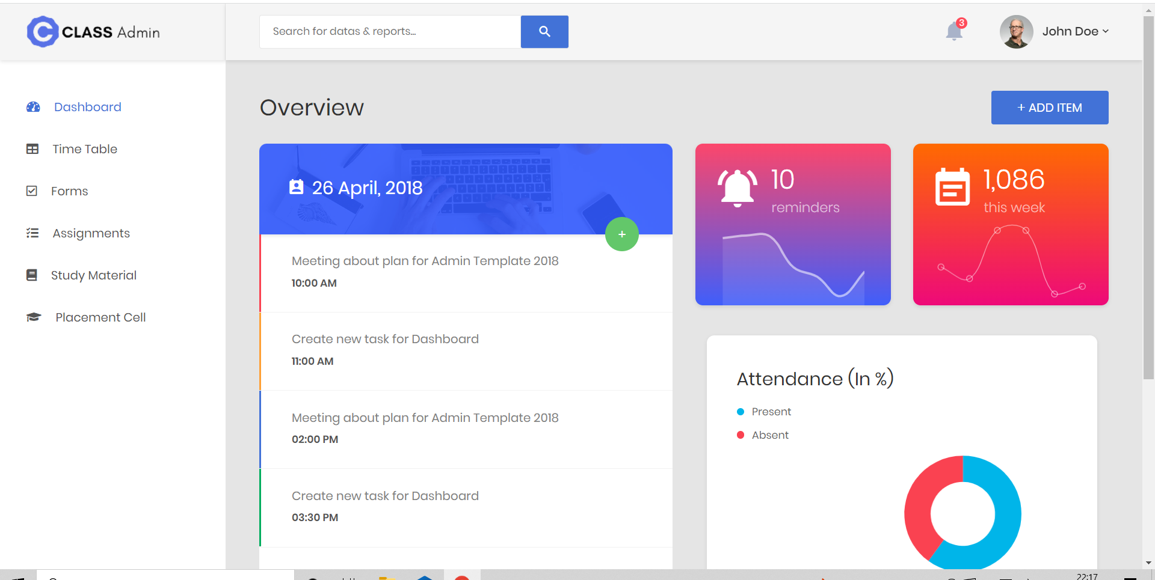
Figure 14. Dashboard Screen

Slide 28
Conclusion
The end result of the mentioned methodology and planned action will be a highly interactive UI with working functionalities of a virtual classroom, which will keep user data secure and will be able to handle customised academic activities for an institution. This application aims to eliminate the use of third party applications being used for various activities in the institution. Also, it will be able to aggregate all these activities to a homogeneous ecosystem, which greatly enhances the user experience and streamline user flow. The system can be used to increase student faculty interaction and also increase their involvement with the college. Also, the aggregation of all the activities on a single platform will help students to perform their curricular and co-curricular activities in an organised manner and it will help them to avoid missing out on important opportunities.

Slide 29
Future Work
IET Pathshala is very useful in many aspects for the students as well as teachers of the institutions to aggregate all the activities at one platform in an organised manner. Though this is currently solving several issues but can be improved in many dimensions.
There will be a messaging application in the classroom where students can form different communities as per their interests and connect with each other, they can share their views and opinions, future career opportunities etc.
We can also include a section for contests and competitions organised by teachers/seniors/alumni.The students can take part in these competitions/hackathons and get inspired to perform better.

Slide 30
References
[1] Shivangi Dhawan,“Online Learning : A panacea in the Time of COVID-19 Crisis”, Journal Of Educational Technology systems ,Vol.49(I) 5-22.December 2020
[2] Saba Maanvizhi, Jiyaram Neha Jaiswal, Ravi Ram Narayanan, Rajendra Rohit Jain,“ A Review on Virtual Classroom”, Indian Journal of Pharmaceutical Education and Research,October 2020
[3] Rajab Ali Biswas, Dr. Soma Nandi,“Teaching in Virtual Classroom: Challenges and Opportunities”,International Journal of Engineering Applied Sciences and Technology, Vol. 5, Issue 1SSN No 2455-2143, May 2020.

Slide 31
[4] Brooke Auxier, Lee Rainie,“Public opinion on Security of Data from companies”, Pew Research Center.Online Learning ,November 2019,
[5] Arvind Mahajan, Assistant Manager,“Virtual Learning Environment”, AIMA Journal of Management & Research,Volume 10 Issue 2/4, ISSN 0974-497 Copyright @ 2016 AJMR-AIMA, 2016
[6] J. Bissonnette, F. Dubé, M.D. Provencher, M.T. Moreno Sala. “Evolution of Music performance anxiety and quality of performance during virtual reality exposure training”, Virtual Reality, Volume 20, Issue 1, pp 71-81,March 2016 .

Slide 32
Thank You
THANK YOU

